Slide 1
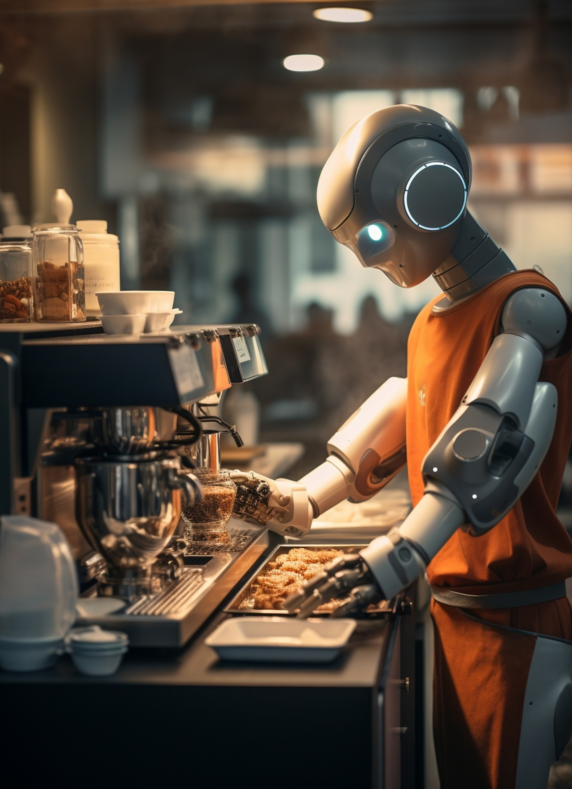
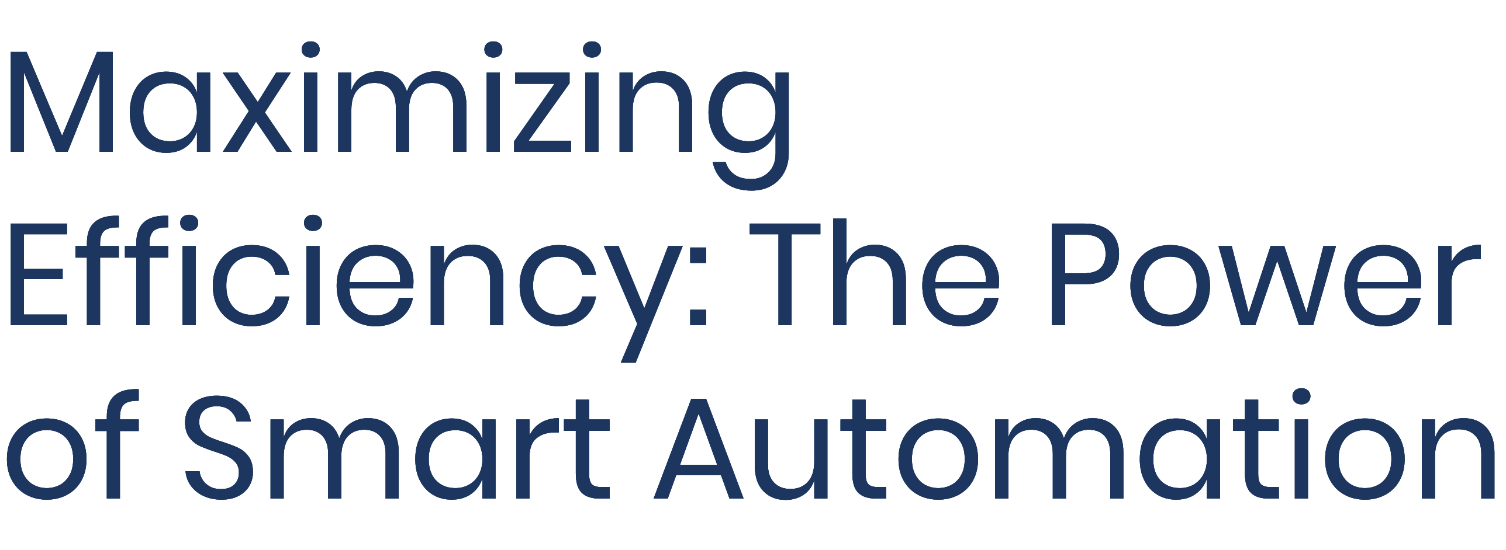
Team code : NQ32
Team name : Bit Chasers
Team members : Prakhar Kansal
Vishwas Miglani
Dhananjay Nagar
Pragyan Sharma
Mukul Joshi
Bipasha Kamra

Slide 2


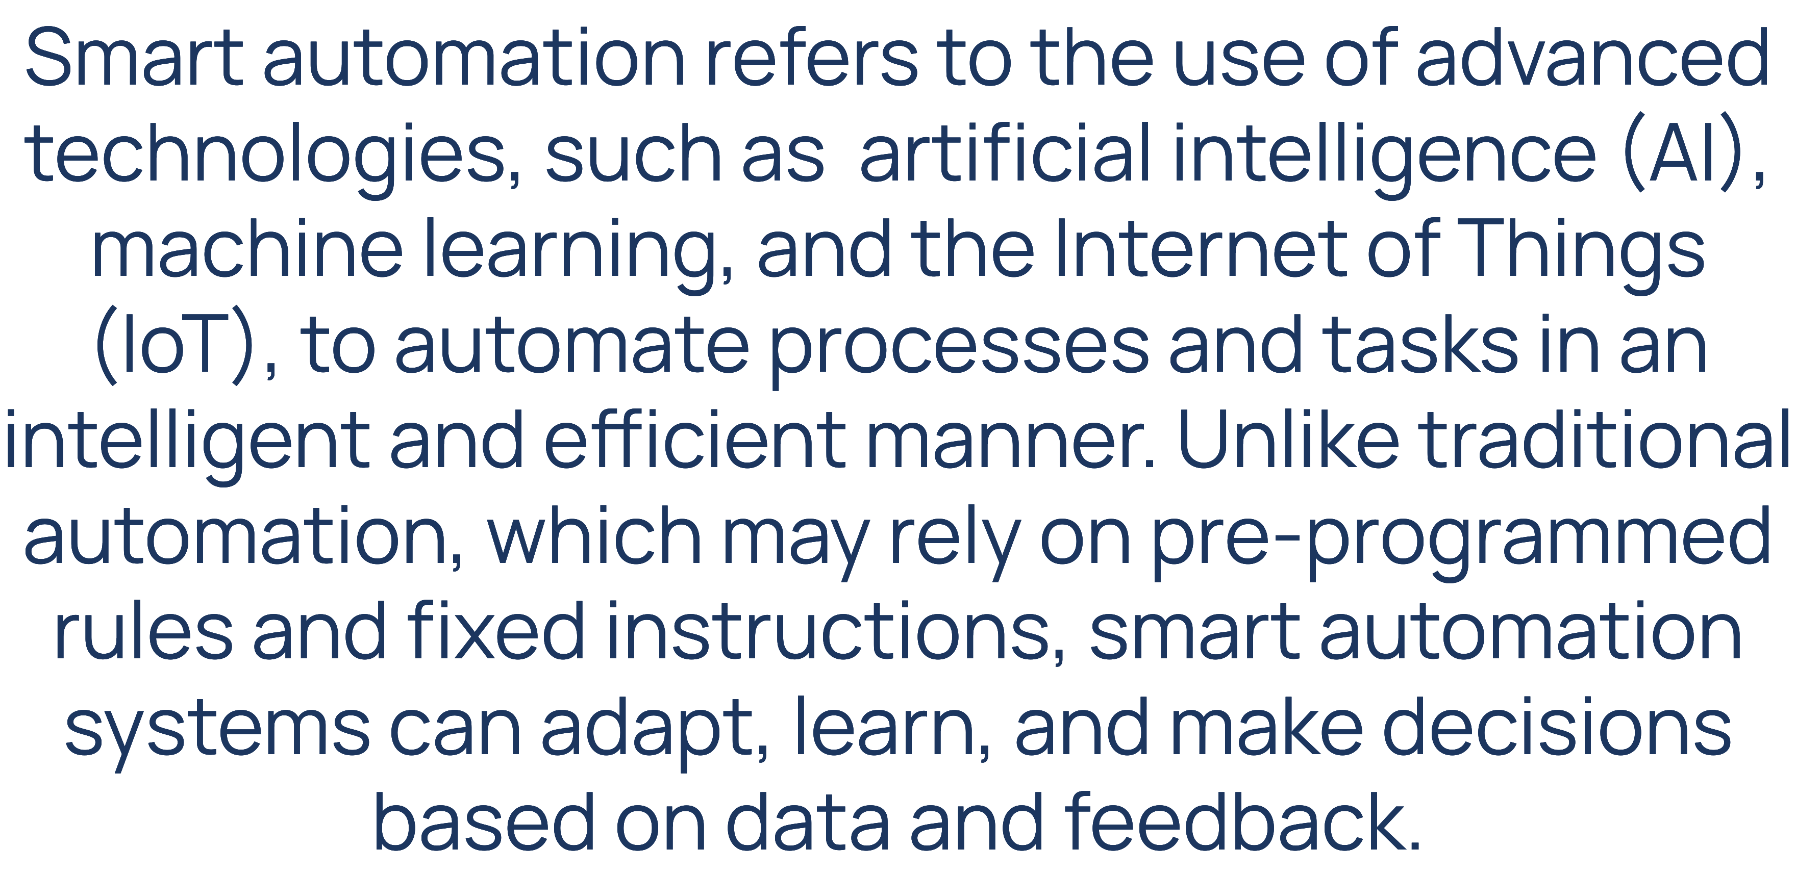

Slide 3

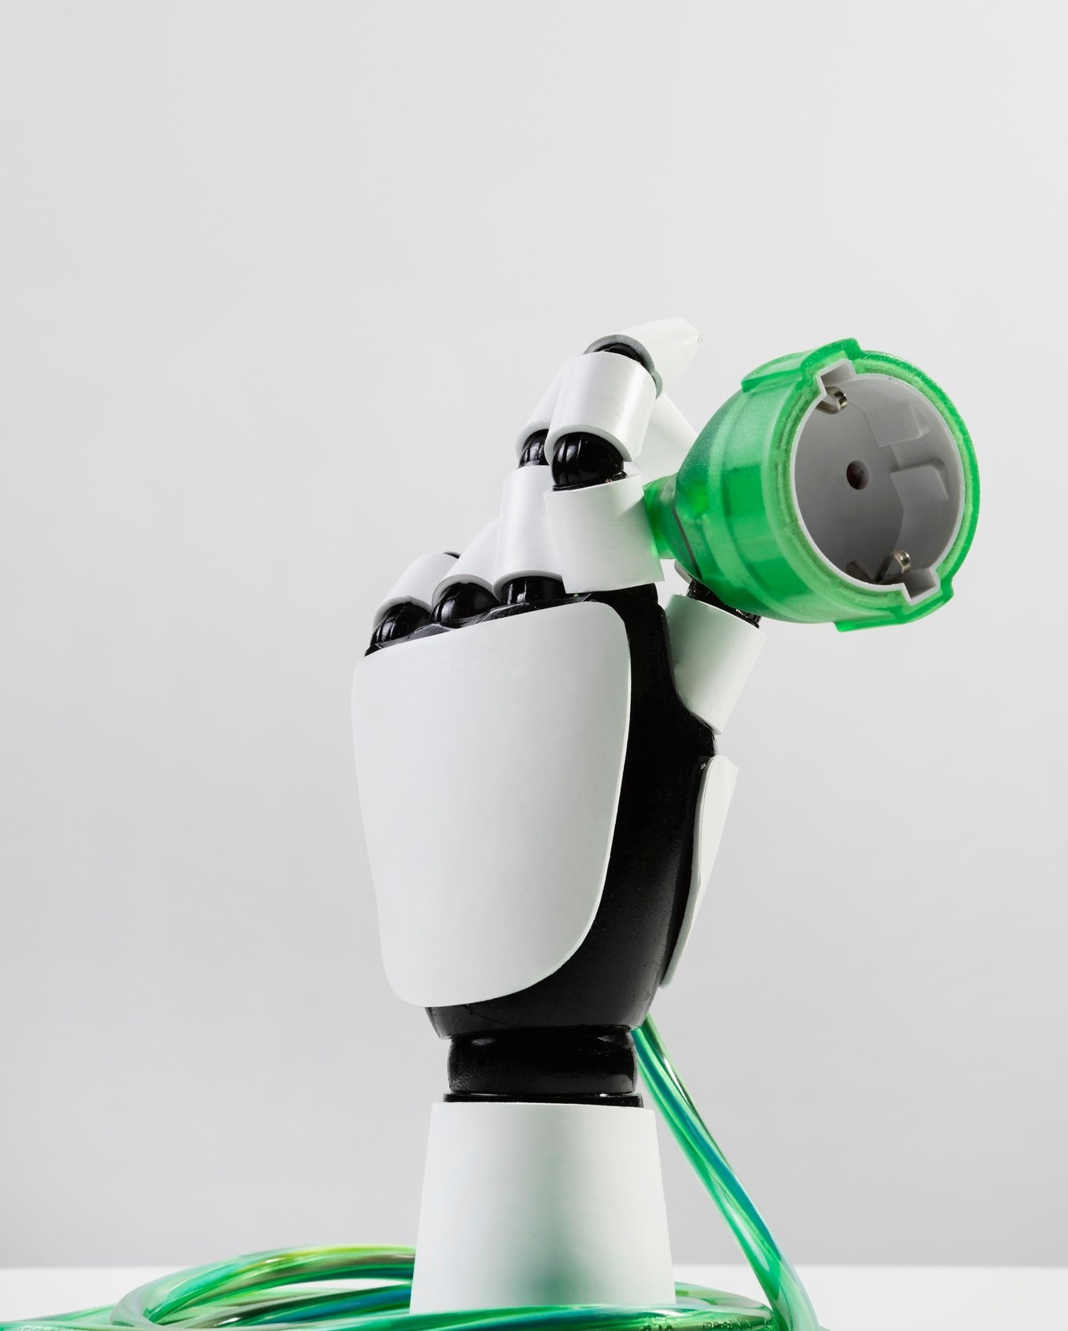
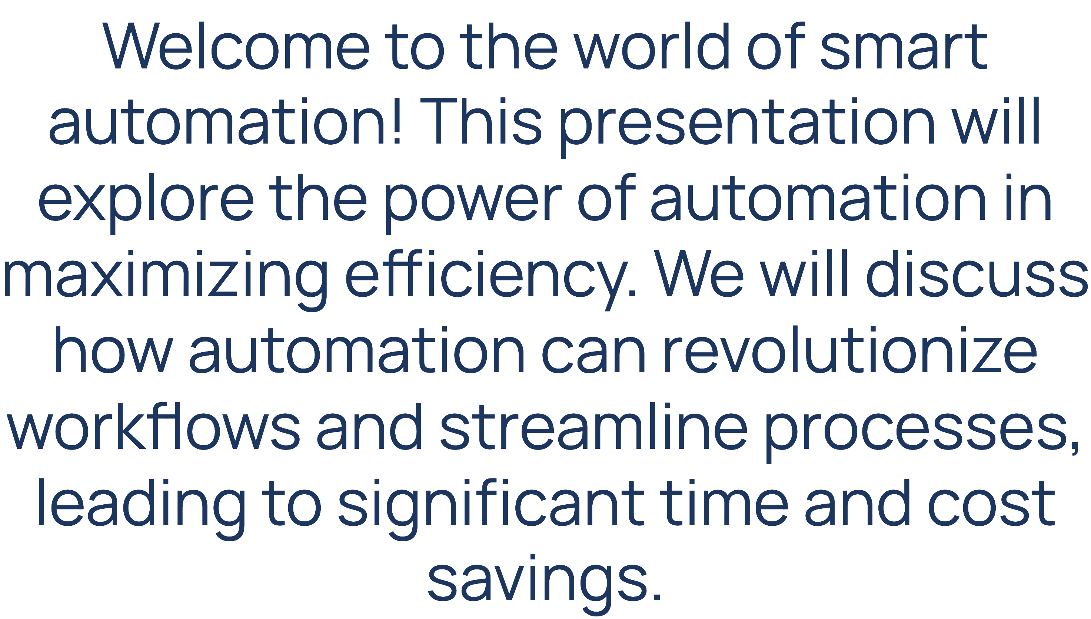

Slide 4

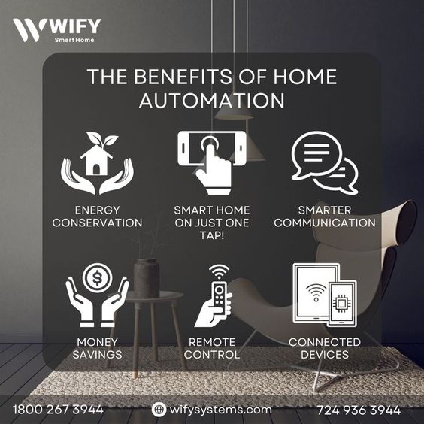
Smart automation offers numerous benefits, including increased productivity, reduced errors, and enhanced scalability. It also frees up employees to focus on more strategic and creative tasks, leading to improved job satisfaction

Slide 5
Technology Stacks
Microcontroller
Cloud Services
IoT Application
Application programming interface (API’s)
Relays
Sensors

Slide 6

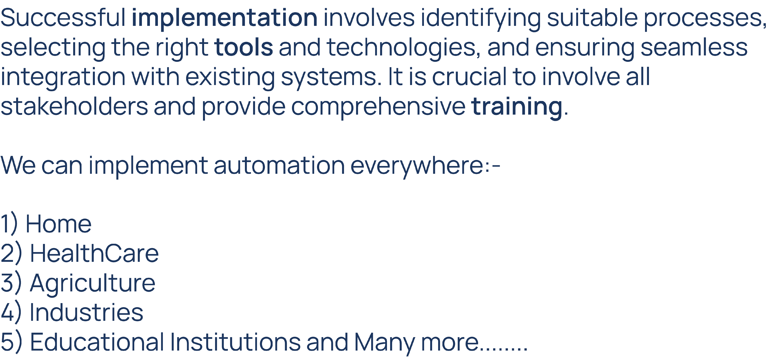

Slide 7
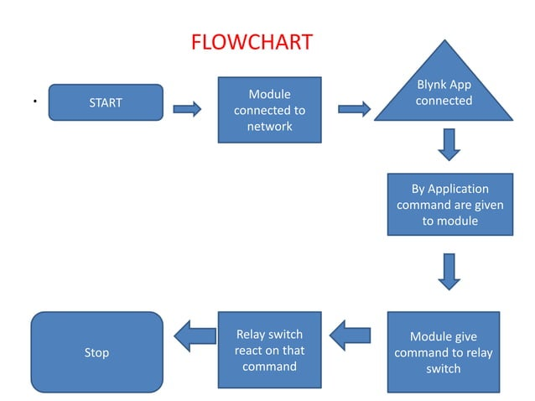

Slide 8
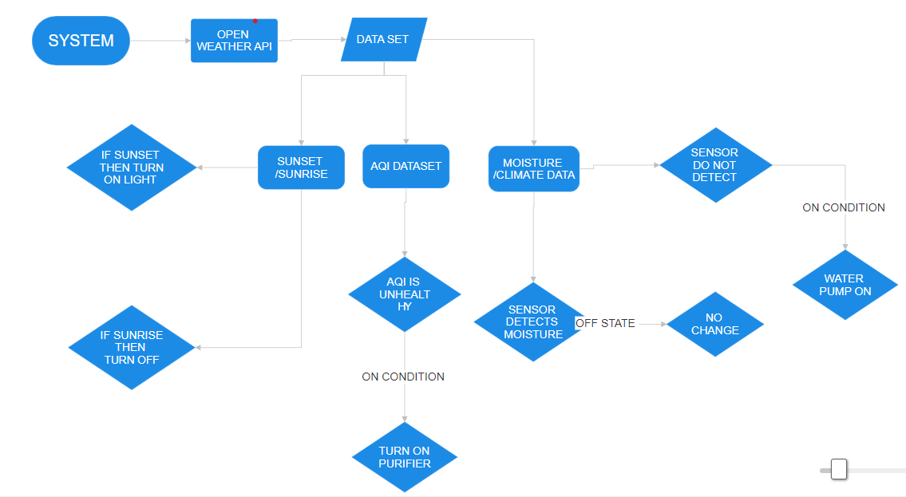

Slide 9


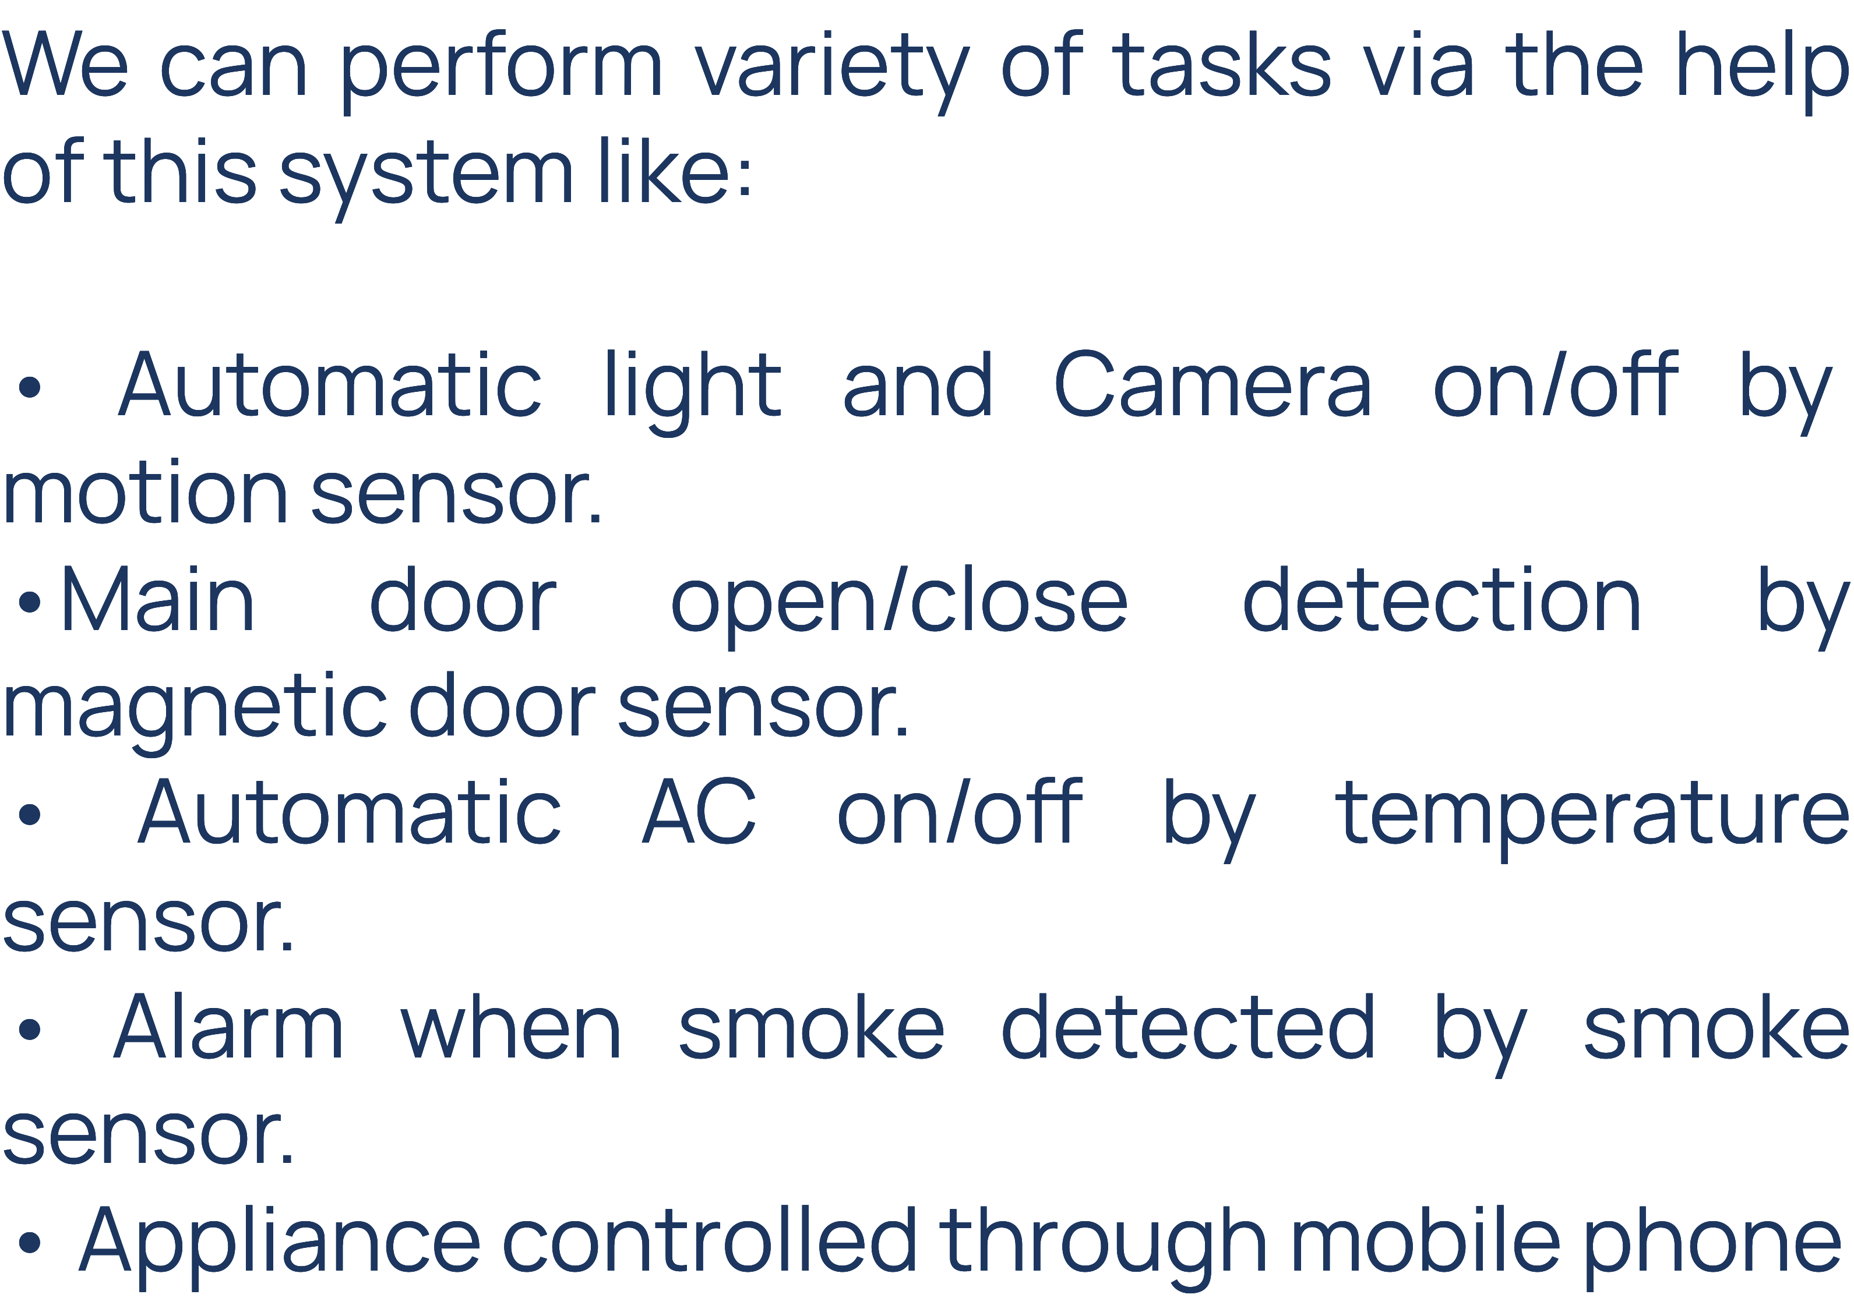

Slide 10

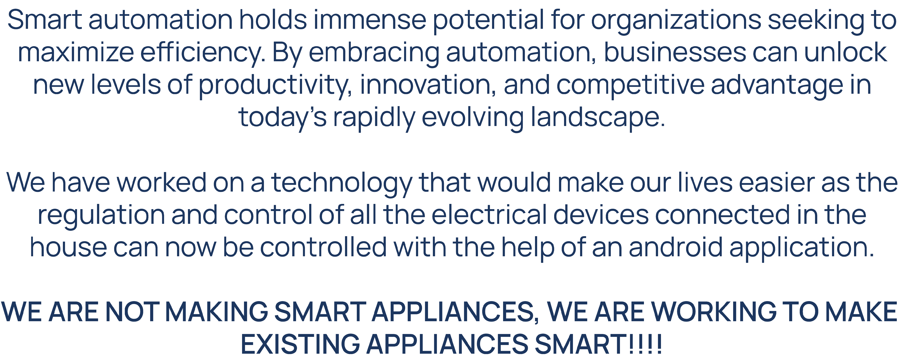

Slide 11
DO YOU HAVE ANY QUESTIONS?

